Slide 1
Discover the Best Model for Identifying Heart Disease
Mike Ye

Slide 2
Conclusion
Purpose
Find the most accurate model by analyzing the Heart Disease Dataset using different models
Determine if the patients are at risk of heart diseases
Random Forest Classifier is the most accurate model

Slide 3
Summary of Dataframe
Variable | Datatype
Age | Float64
Sex | Float64
CP | Float64
Trestbps | Float64
Chol | Float64
FBS | Float64
Restecg | Float64
Thalach | Float64
Exang | Float64
Oldpeak | Float64
Slope | Float64
CA | Object
Thal | Object
Num | int64
303 entries (non-null)
total 14 columns
Continuous or Categorical
Categorical
First step: clean the data

Slide 4
Abbreviation for Features
CP = Chest Pain ( 1 - typical angina, 2 - atypical angina, 3 - non-anginal pain, 4 - asymptomatic )
Trestbps = Resting Blood Pressure
Chol = Serum Cholesterol
FBS = Fasting Blood Sugar ( 0 - false, 1 - true)
Restecg = Resting Electrocardiographic Results ( 0 - normal, 1 - little abnormal, 2 - symptom )
Thalach = Maximum Heart Rate
Exang = Exercise Induced Angina ( 0 - no, 1 - yes )
Oldpeak = ST Depression Induced by Exercise
Slope = Slope of the Peak Exercise ST Segment ( 1 - upslope, 2 - flat, 3 - downslope )
CA = Number of Major Vessels ( 0 - 3 )
Thal = ( 3 - normal, 6 - fixed defect, 7 - reversible defect )
Num = Diagnosis of Heart Disease
Value 0 - < 50% diameter narrowing
Value 1 - > 50% diameter narrowing

Slide 5
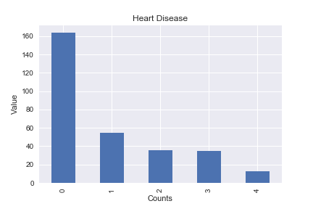
Convert the Target Variable
Num = Diagnosis of Heart Disease
( Value 0 - < 50% diameter narrowing; Value 1 - > 50% diameter narrowing )
Value | Counts
0 | 164
1 | 55
2 | 36
3 | 35
4 | 13
Severity Increase
Purpose of this project is to determine if the patient has heart disease
Severity of the disease is not necessary
Make the target variable binary (0 – low risk; 1 – at risk)

Slide 6
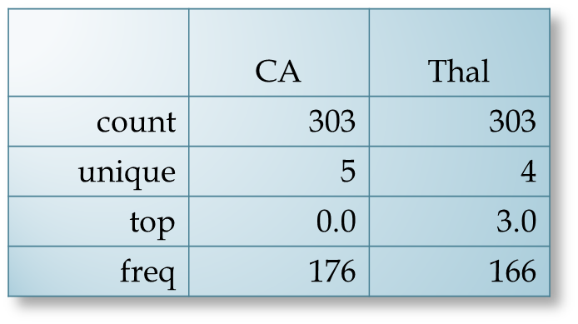
Cleansing the Null Values
Imputation Method
CA
Thal
CA = Number of Major Vessels ( 0 - 3 )
should have 4 unique numbers
Thal = ( 3 - normal, 6 - fixed defect, 7 - reversible defect )
should have 3 unique numbers
Value | Counts
0 | 176
1 | 65
2 | 38
3 | 20
? | 4
Value | Counts
3 | 166
6 | 18
7 | 117
? | 2

Slide 7
Convert Categorical Variables into Binary Variables
CP = Chest Pain ( 1 - typical angina, 2 - atypical angina, 3 - non-anginal pain, 4 - asymptomatic )
Restecg = Resting Electrocardiographic Results ( 0 - normal, 1 - little abnormal, 2 - symptom )
Slope = Slope of the Peak Exercise ST Segment ( 1 - upslope, 2 - flat, 3 - downslope )
CA = Number of Major Vessels ( 0 - 3 )
Thal = ( 3 - normal, 6 - fixed defect, 7 - reversible defect )
 |  | CA (Number of Major Vessels) |  |  |  | Thal
 | ... | [0] | [1] | [2] | [3] | [3] | [6] | [7]
0 | ... | 1.0 | 0.0 | 0.0 | 0.0 | 0.0 | 1.0 | 0.0
1 | ... | 0.0 | 0.0 | 0.0 | 1.0 | 1.0 | 0.0 | 0.0
2 | ... | 0.0 | 0.0 | 1.0 | 0.0 | 0.0 | 0.0 | 1.0
3 | ... | 1.0 | 0.0 | 0.0 | 0.0 | 1.0 | 0.0 | 0.0
4 | ... | 1.0 | 0.0 | 0.0 | 0.0 | 1.0 | 0.0 | 0.0

Slide 8
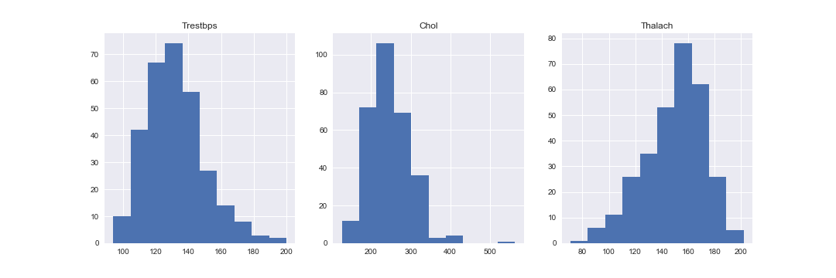
Eliminate Outliers
These three continuous variables that are most likely to have outliers are ‘Trestbps’, ‘Chol’, and ‘Thalach’
Method Used
Trestbps = Resting Blood Pressure
Chol = Serum Cholesterol
Thalach = Maximum Heart Rate

Slide 9
Prepare Data for Modeling
Normalization
Training/Test sets
Shuffle Data
Min-Max Normalization
Improve data integrity
Divide the dataset into:
90% training set
Used to train the model
Find predicative relationship
Get an expected accuracy score
10% test set
Assess the predicative relationship
Evaluate the expected value
Create a function to shuffle the dataset for randomness in training and test set
Usage
Notes:
Talk about training and test in new slide
All these models used the same dataset

Slide 10
Start Modeling
Following five models were compared:
Logistic Regression
Gradient Boost Classifier
Random Forest Classifier
Support Vector Classifier
K-Nearest Neighbors
Notes:
Talk about training and test in new slide
All these models used the same dataset

Slide 11
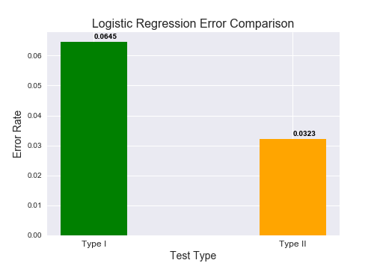
Logistic Regression
Percentage Accuracy (Training)
0.86764
Training set accuracy:
Percent Type I errors: 0.05147
Percent Type II errors: 0.08088
Percentage Accuracy (Test)
0.90322
Test set accuracy:
Percent Type I errors: 0.06451
Percent Type II errors: 0.03225
Note:
[1, 0] - Type II ~ False Negative cases
[0, 1] - Type I ~ False Positive cases
Accuracy of Heart Disease Diagnostics:
Training Set:
Expected | 0 | 1
Actual
0 | 134 | 12
1 | 20 | 106
Test Set
Expected | 0 | 1
Actual
0 | 12 | 6
1 | 2 | 11
Notes:
This is the sample case, not always representative
Focus the percentage accuracy of test set

Slide 12
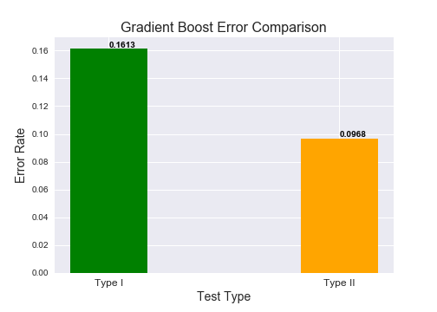
Gradient Boost
Percentage Accuracy (Training)
0.84926
Training set accuracy:
Percent Type I errors: 0.05882
Percent Type II errors: 0.09191
Percentage Accuracy (Test)
0.74193
Test set accuracy:
Percent Type I errors: 0.16129
Percent Type II errors: 0.09677
Note:
[1, 0] - Type II ~ False Negative cases
[0, 1] - Type I ~ False Positive cases
Accuracy of Heart Disease Diagnostics:
Training Set:
Expected | 0 | 1
Actual
0 | 129 | 16
1 | 25 | 102
Test Set
Expected | 0 | 1
Actual
0 | 14 | 5
1 | 3 | 9

Slide 13
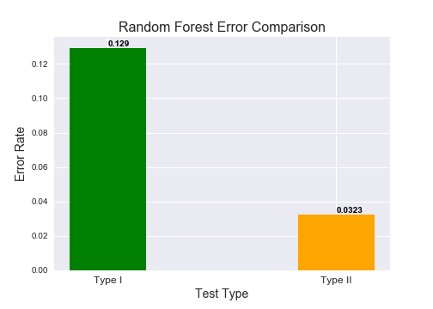
Random Forest
Percentage Accuracy (Training)
0.92647
Training set accuracy:
Percent Type I errors: 0.02941
Percent Type II errors: 0.04411
Percentage Accuracy (Test)
0.83870
Test set accuracy:
Percent Type I errors: 0.12903
Percent Type II errors: 0.03225
Note:
[1, 0] - Type II ~ False Negative cases
[0, 1] - Type I ~ False Positive cases
Accuracy of Heart Disease Diagnostics:
Training Set:
Expected | 0 | 1
Actual
0 | 137 | 8
1 | 12 | 115
Test Set
Expected | 0 | 1
Actual
0 | 15 | 4
1 | 1 | 11

Slide 14
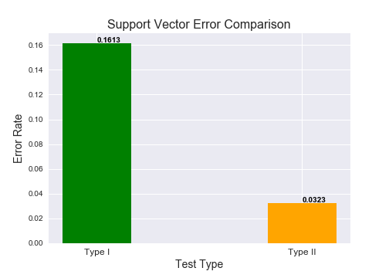
Support Vector
Percentage Accuracy (Training)
0.86029
Training set accuracy:
Percent Type I errors: 0.06617
Percent Type II errors: 0.07352
Percentage Accuracy (Test)
0.80645
Test set accuracy:
Percent Type I errors: 0.16129
Percent Type II errors: 0.03225
Note:
[1, 0] - Type II ~ False Negative cases
[0, 1] - Type I ~ False Positive cases
Accuracy of Heart Disease Diagnostics:
Training Set:
Expected | 0 | 1
Actual
0 | 127 | 18
1 | 20 | 107
Test Set
Expected | 0 | 1
Actual
0 | 14 | 5
1 | 1 | 11

Slide 15
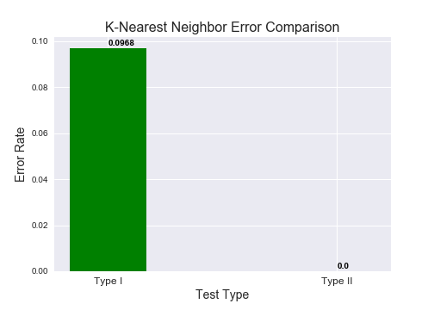
K-Nearest Neighbor
Percentage Accuracy (Training)
0.85661
Training set accuracy:
Percent Type I errors: 0.05514
Percent Type II errors: 0.08823
Percentage Accuracy (Test)
0.90322
Test set accuracy:
Percent Type I errors: 0.09677
Percent Type II errors: 0.0
Note:
[1, 0] - Type II ~ False Negative cases
[0, 1] - Type I ~ False Positive cases
Accuracy of Heart Disease Diagnostics:
Training Set:
Expected | 0 | 1
Actual
0 | 130 | 15
1 | 24 | 103
Test Set
Expected | 0 | 1
Actual
0 | 16 | 3
1 | 0 | 12

Slide 16
Try PCA
Test if PCA will increase the accuracy rate of each classifiers
Reduce the dimensions of the dataset can also increase runtime efficiency
Create 13 meta features that can explain at least 85% of variance in the dataset

Slide 17
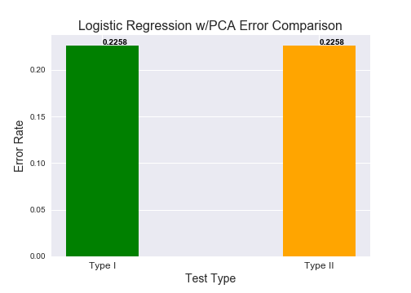
Logistic Regression w/ PCA
Percentage Accuracy (Training)
0.87132
Training set accuracy:
Percent Type I errors: 0.26470
Percent Type II errors: 0.29411
Percentage Accuracy (Test)
0.77419
Test set accuracy:
Percent Type I errors: 0.22580
Percent Type II errors: 0.22580
Note:
[1, 0] - Type II ~ False Negative cases
[0, 1] - Type I ~ False Positive cases
Accuracy of Heart Disease Diagnostics:
Training Set:
Expected | 0 | 1
Actual
0 | 134 | 16
1 | 19 | 103
Test Set
Expected | 0 | 1
Actual
0 | 13 | 1
1 | 6 | 11

Slide 18
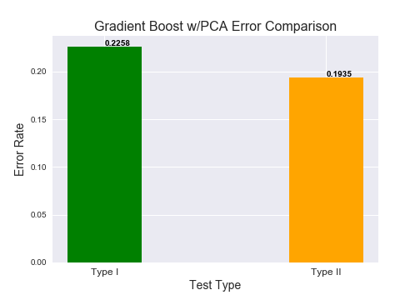
Gradient Boost w/ PCA
Percentage Accuracy (Training)
0.88602
Training set accuracy:
Percent Type I errors: 0.25735
Percent Type II errors: 0.30147
Percentage Accuracy (Test)
0.74193
Test set accuracy:
Percent Type I errors: 0.22580
Percent Type II errors: 0.19354
Note:
[1, 0] - Type II ~ False Negative cases
[0, 1] - Type I ~ False Positive cases
Accuracy of Heart Disease Diagnostics:
Training Set:
Expected | 0 | 1
Actual
0 | 138 | 12
1 | 19 | 103
Test Set
Expected | 0 | 1
Actual
0 | 12 | 2
1 | 6 | 11

Slide 19
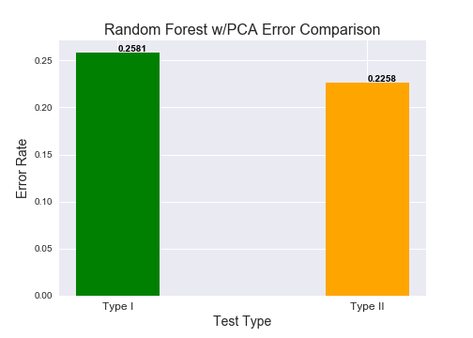
Random Forest w/ PCA
Percentage Accuracy (Training)
0.96691
Training set accuracy:
Percent Type I errors: 0.25735
Percent Type II errors: 0.27205
Percentage Accuracy (Test)
0.80645
Test set accuracy:
Percent Type I errors: 0.25806
Percent Type II errors: 0.22580
Note:
[1, 0] - Type II ~ False Negative cases
[0, 1] - Type I ~ False Positive cases
Accuracy of Heart Disease Diagnostics:
Training Set:
Expected | 0 | 1
Actual
0 | 145 | 5
1 | 4 | 118
Test Set
Expected | 0 | 1
Actual
0 | 13 | 1
1 | 5 | 12

Slide 20
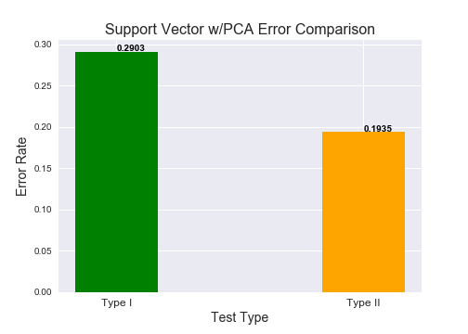
Support Vector w/ PCA
Percentage Accuracy (Training)
0.87867
Training set accuracy:
Percent Type I errors: 0.26838
Percent Type II errors: 0.29779
Percentage Accuracy (Test)
0.80645
Test set accuracy:
Percent Type I errors: 0.29032
Percent Type II errors: 0.19354
Note:
[1, 0] - Type II ~ False Negative cases
[0, 1] - Type I ~ False Positive cases
Accuracy of Heart Disease Diagnostics:
Training Set:
Expected | 0 | 1
Actual
0 | 135 | 15
1 | 18 | 104
Test Set
Expected | 0 | 1
Actual
0 | 12 | 2
1 | 4 | 13

Slide 21
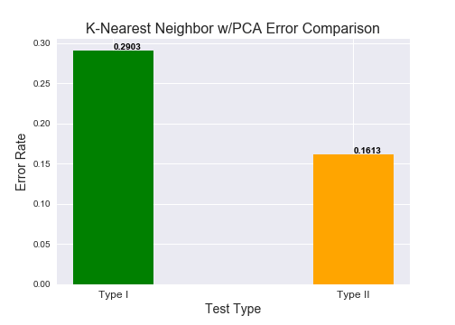
K-Nearest Neighbor w/ PCA
Percentage Accuracy (Training)
0.87132
Training set accuracy:
Percent Type I errors: 0.26102
Percent Type II errors: 0.28308
Percentage Accuracy (Test)
0.83870
Test set accuracy:
Percent Type I errors: 0.29032
Percent Type II errors: 0.16129
Note:
[1, 0] - Type II ~ False Negative cases
[0, 1] - Type I ~ False Positive cases
Accuracy of Heart Disease Diagnostics:
Training Set:
Expected | 0 | 1
Actual
0 | 133 | 17
1 | 18 | 104
Test Set
Expected | 0 | 1
Actual
0 | 12 | 2
1 | 3 | 14

Slide 22
Summary Statistics of Models
mean 0.836134 0.857189 0.868521 0.915137 0.850557 std 0.064883 0.058254 0.056780 0.045863 0.060357
 | Gradient Boost | KNN | Logistic Regression | Random Forest | SVM
Count | 501 | 501 | 501 | 501 | 501
Mean | 0.836 | 0.857 | 0.868 | 0.915 | 0.850
Standard Deviation | 0.064 | 0.058 | 0.056 | 0.045 | 0.060
Conclusion: PCA did not improve the models
 | Gradient Boost | KNN | Logistic Regression | Random Forest | SVM
PCA Results | 0.741 | 0.838 | 0.774 | 0.806 | 0.806

Slide 23
T-Test Results
T-Test Results |  | Gradient Boost | K-Nearest Neighbor | Logistic Regression | Random Forest | Support Vector
Gradient Boost | T-Value: P-Value: |  | 5.4046 8.1204e-08 | 8.4078 1.4253e-16 | 22.2555 1.8838e-89 | 3.6429 0.0002
K-Nearest Neighbor | T-Value: P-Value: | -5.4046 8.1204e-08 |  | 3.1180 0.0018 | 17.4945 5.4241e-60 | -1.7696 0.0770
Logistic Regression | T-Value: P-Value: | 8.4078 1.4253e-16 | -3.1180 0.0018 |  | 14.2955 2.1909e-69 | -4.8522 1.4152e-06
Random Forest | T-Value: P-Value: | -22.2555 1.8838e-89 | -17.4945 5.4241e-60 | -14.2955 2.5478e-42 |  | -19.0688 2.1909e-69
Suppor Vector | T-Value: P-Value: | -3.6429 0.0002 | 1.7696 0.0770 | 4.8522 1.4152e-06 | 19.0688 2.1909e-69
Notes:
Do not need to explain the T and P value too much

Slide 24
Conclusion
The Random Forest Classifier is the most accurate for this dataset, because it has the highest accuracy rate and least variance.
Not recommended to use PCA
From the T-test, it shows that Random Forest Classifier are also statistically significant in comparison to other classifiers because smaller p-values and higher t-values.

Slide 25
Future Notes
Tweak the parameters, can affect the results of the models
More dataset, 303 is a very small dataset
Or change the proportion of training/test sets
False Negative/Positive can also be a metric
Check Feature Importance

Slide 26
Imputation
Decided to impute the values using ‘most-frequent’ strategy
Locate Index
Replace ‘?’ with null
Change to Float type
Impute Missing Values
ca_index = df.loc[df.CA == '?'].index
thal_index = df.loc[df.Thal == '?'].index
ind = ca_index.append(thal_index)
for i in ind:
df.iloc[i:] = df.iloc[i:].replace('?', '')
df['CA'] = pd.to_numeric(df['CA']).astype(float)
df['Thal'] = pd.to_numeric(df['Thal']).astype(float)
col_names = df.columns # Rename the columns after imputation
imp = Imputer(missing_values = 'NaN', strategy = 'most_frequent')
new_df = imp.fit_transform(df)
new_df = pd.DataFrame(new_df, columns = col_names)
Back

Slide 27
Remove Outliers
Identify Outlier
Temporarily drop the outlier
new_df = new_df.drop(new_df.index[ind_chol.index])
Replace outlier with max value in ‘Chol’
ind_chol = new_df.loc[new_df['Chol'] > 500]
max_chol = new_df['Chol'].max()
new_df = new_df.append(ind_chol)
Add the outlier back
ind_chol['Chol'] = max_chol
Back

Slide 28
Run 500 trials of Test Set
for i in range(500):
# shuffle the original df
new_shuf_df = shuffle_data(shuf_df)
# set targeted variable and features
Y = new_shuf_df['Num']
X = new_shuf_df.loc[:, ~new_shuf_df.columns.isin(['Num'])]
# create a new test set
new_X_test, new_Y_test = X[trainsize:], Y[trainsize:]
# run the models
compare_df = compare_df.append({'lr':lr.score(new_X_test, new_Y_test),
'gbc':gbc.score(new_X_test, new_Y_test),
'rfc':rfc.score(new_X_test, new_Y_test),
'svc':svc.score(new_X_test, new_Y_test),
'knn':knn.score(new_X_test, new_Y_test)},
ignore_index = True)
compare_df.index.name = 'Tests'
Back

Slide 29
T-Test Results
T-Test Results |  | Gradient Boost | K-Nearest Neighbor | Logistic Regression | Random Forest | Support Vector
Gradient Boost | T-Value: |  | 5.4046 | 8.4078 | 22.2555 | 3.6429
 | P-Value: |  | 8.1204e-08 | 1.4253e-16 | 1.8838e-89 | 0.0002
K-Nearest Neighbor | T-Value: | -5.4046 |  | 3.1180 | 17.4945 | -1.7696
 | P-Value: | 8.1204e-08 |  | 0.0018 | 5.4241e-60 | 0.0770
Logistic Regression | T-Value: | 8.4078 | -3.1180 |  | 14.2955 | -4.8522
 | P-Value: | 1.4253e-16 | 0.0018 |  | 2.1909e-69 | 1.4152e-06
Random Forest | T-Value: | -22.2555 | -17.4945 | -14.2955 |  | -19.0688
 | P-Value: | 1.8838e-89 | 5.4241e-60 | 2.5478e-42 |  | 2.1909e-69
Suppor Vector | T-Value: | -3.6429 | 1.7696 | 4.8522 | 19.0688
 | P-Value: | 0.0002 | 0.0770 | 1.4152e-06 | 2.1909e-69
Notes:
Do not need to explain the T and P value too much

